Slide 1
CSC1004 Tutorial 3 Shihao Hong

Slide 2
Java Socket Programming
Java Socket programming is used for communication between the applications running on different Java Runtime Environment (JRE).
JRE is a software layer that runs on top of a computer’s operating system software and provides the class libraries and other resources that a specific Java program needs to run.
Java Socket programming can be connection-oriented or connection-less.
Socket and ServerSocket classes are used for connection-oriented socket programming and DatagramSocket and DatagramPacket classes are used for connection-less socket programming.
Socket and ServerSocket may be important for our Project #1.
The client in socket programming must know two information:
IP Address of Server.
Port number.

Slide 3
Class Socket
Class Socket implements client sockets (also called just "sockets"). A socket is an endpoint for communication between two machines.
A class in Java is a logical template to create objects that share common properties and methods. Hence, all objects in a given class will have the same methods or properties.
The actual work of the socket is performed by an instance of the SocketImpl class. An application, by changing the socket factory that creates the socket implementation, can configure itself to create sockets appropriate to the local firewall.
In project #1, Socket is used to implement the clients sockets, where socket.getOutputStream() and socket.getInputStream() in the “Client” Class are used to write and read messages.
BufferedWriter(new OutputStreamWriter((socket.getOutputStream()))); // Write
BufferedReader((new InputStreamReader(socket.getInputStream()))); // Read

Slide 4
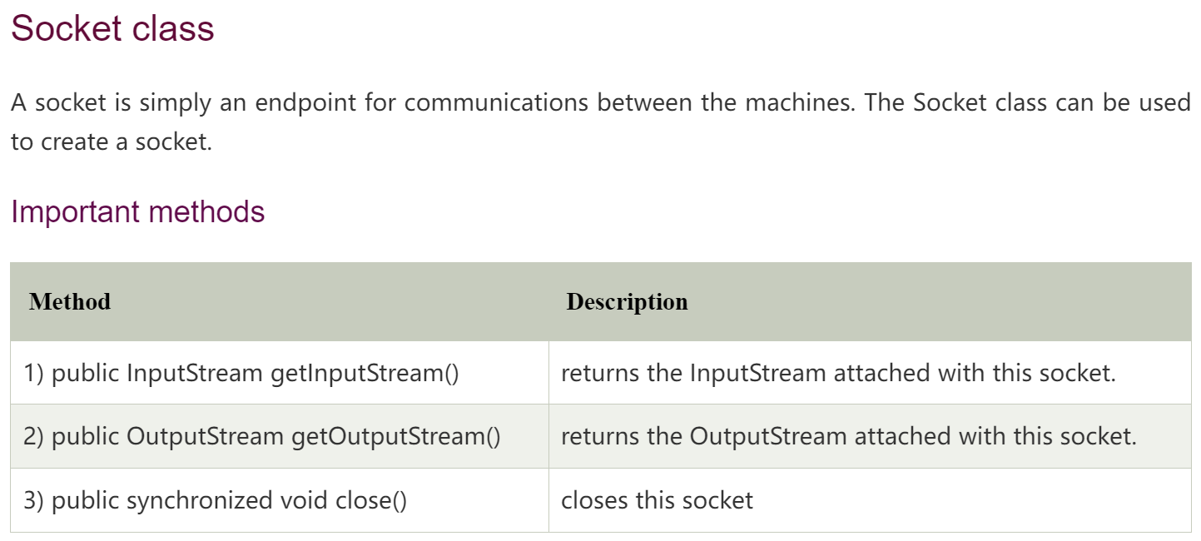
Class Socket

Slide 5
Class ServerSocket
Class ServerSocket This class implements server sockets. A server socket waits for requests to come in over the network. It performs some operation based on that request, and then possibly returns a result to the requester.
The actual work of the server socket is performed by an instance of the SocketImpl class. An application can change the socket factory that creates the socket implementation to configure itself to create sockets appropriate to the local firewall.
In project #1, ServerSocket is used to implement the server socket.
ServerSocket serverSocket = new ServerSocket(1004); // Creates a server socket, bound to the specified port.
Socket socket = serverSocket.accept(); // returns the socket and establish a connection between server and client.

Slide 6
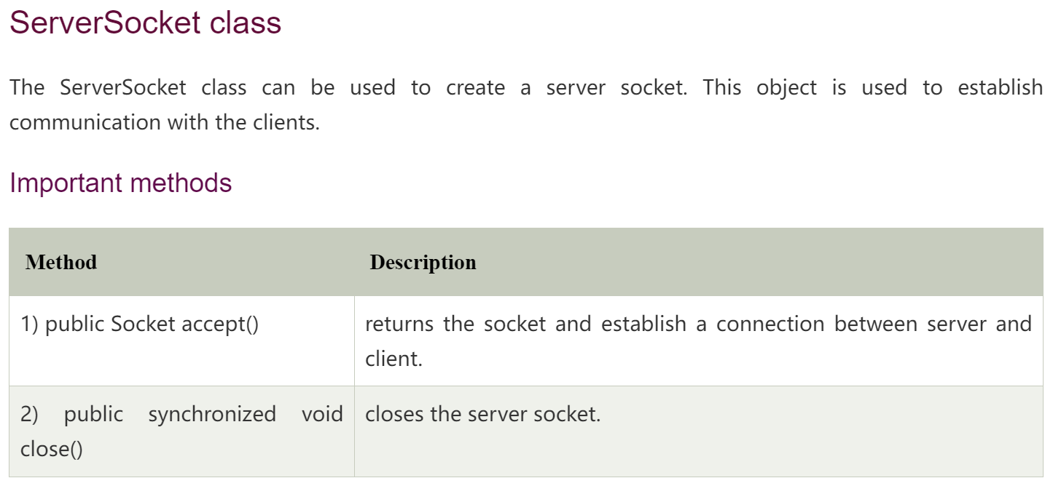
Class ServerSocket

Slide 7
Server in Project #1
public class Server{
private ServerSocket serverSocket; // See previous slides, serverSocket is used to implement the server
public Server(ServerSocket serverSocket) {
this.serverSocket = serverSocket; // “this.serverSocket” refers to the private “serverSocket” in this class
}
public void startServer(){
while(!serverSocket.isClosed()){
Socket socket = serverSocket.accept(); // See previous slides, returns the socket and establish a connection between server and client
// Codes needed here to handle the clients with Multithreading techniques
}
}
// Note that other functions, e.g., closing the server, are required
public static void main(String[] args) throws IOException { // the “main” function
ServerSocket serverSocket = new ServerSocket(1004); // “1004” is the port number, could be other numbers
Server server = new Server(serverSocket);
server.startServer();
}
}

Slide 8
Client(s) in Project #1
public class Client{
private Socket socket; // See previous slides, socket is used to implement the client
private BufferedReader bufferedReader; // Read from the server
private BufferedWriter bufferedWriter; // Write to the terminal
private String username;
public Client(Socket socket, String username){
this.socket = socket;
this.bufferedWriter = new BufferedWriter(new OutputStreamWriter((socket.getOutputStream())));
this.bufferedReader = new BufferedReader((new InputStreamReader(socket.getInputStream())));
this.username = username;}
public void sendMessage(){// Functions leveraging bufferedWriter}
public void listenForMessage(){// Functions leveraging bufferedReader}
// Note that other functions, e.g., closing the client, are required
public static void main(String[] args) throws IOException {// the “main” function
Socket socket = new Socket("localhost", 1004); // In this project “localhost” is fine. Also, the port number should be equal to the serverSocket.
Client client = new Client(socket, username);
client.listenForMessage();
client.sendMessage();}
}

Slide 9
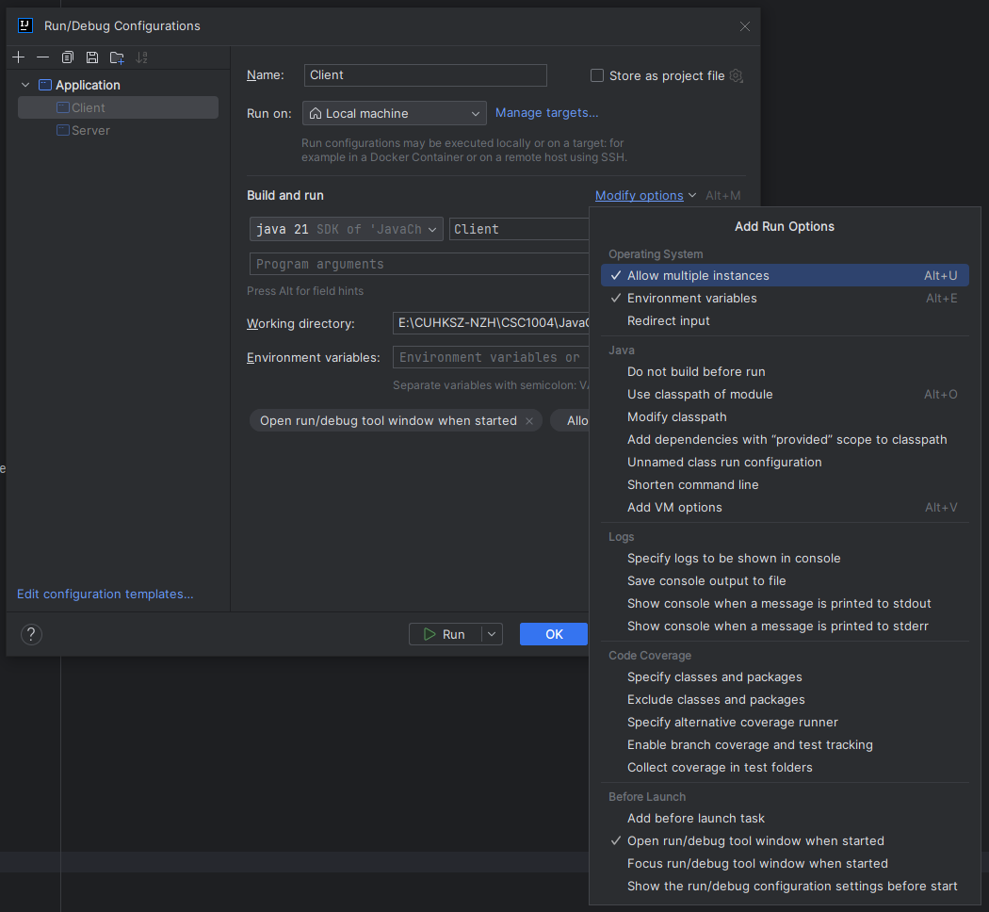
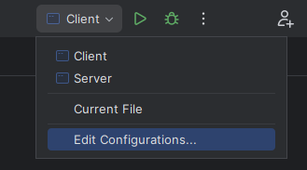
How to Run Multiple Clients?
First, find and click the “Edit Configuration” button on the upper-right position of IntelliJ IDEA.
Next, click “Modify options” button.
Then, select “Allow multiple instances” as show in this page.
Therefore, multiple clients could be run…
⓶
⓷
⓵

Slide 10
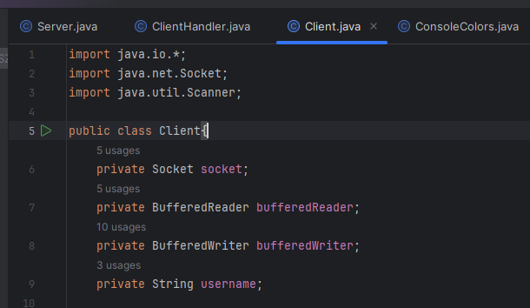
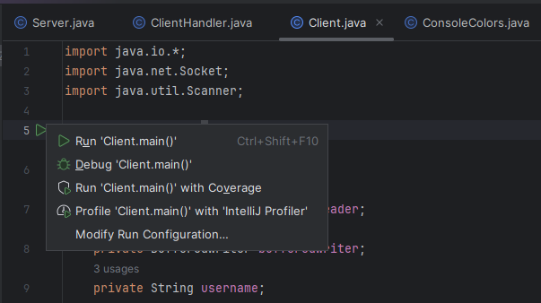

How to Run Multiple Clients?
Next, find your Client class.
Then click the green triangle button and click “Run ‘Client.main()’”.
Note that one click creates one Client instance.
⓵
⓶
⓷

Slide 11

THANK YOU
林天麟 教授
香港中文大学（深圳）
机器人与人工智能实验室
WeChat: tinlunlam

